Slide 1
Setting up a Tsunami Simulation in Thetis

Slide 2
Contents
Pre-processing
Create Mesh
Create the Initial Elevation
Create the Boundary Function
Configuring Thetis
Loading the Bathymetry
Loading the Boundary functions
Accounting for the Coriolis effect
Add detectors
Add the Boundary and Initial Conditions
Visualizing the results

Slide 3
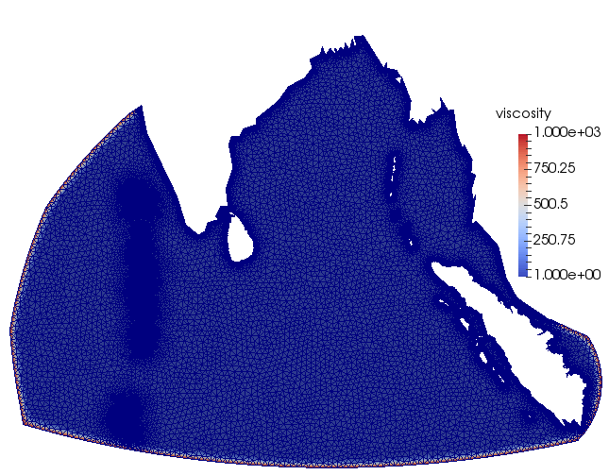
Pre-processing
Create Mesh
Create the Initial Elevation
Create Boundary Functions
Fig : Viscosity Boundary

Slide 4
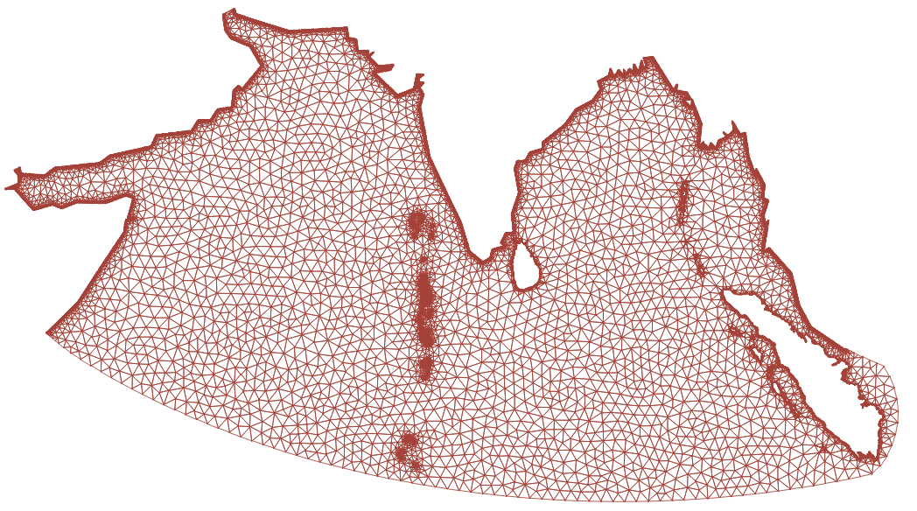
Pre-processing : Create Mesh
Create the Shape Files.
Coastlines
Coastlines can be obtained from GSSHG (Global Self-consistent, Hierarchical, High-resolution Geography)
Boundaries
The boundary should be chosen as that the bathymetry is deep enough in comparison to the horizontal scale of the domain.
We will use qmesh to create the mesh. qmesh is 'an open-source and robust mesh-generation suite for geophysical domains'.
Fig : Mesh across the Indian ocean

Slide 5
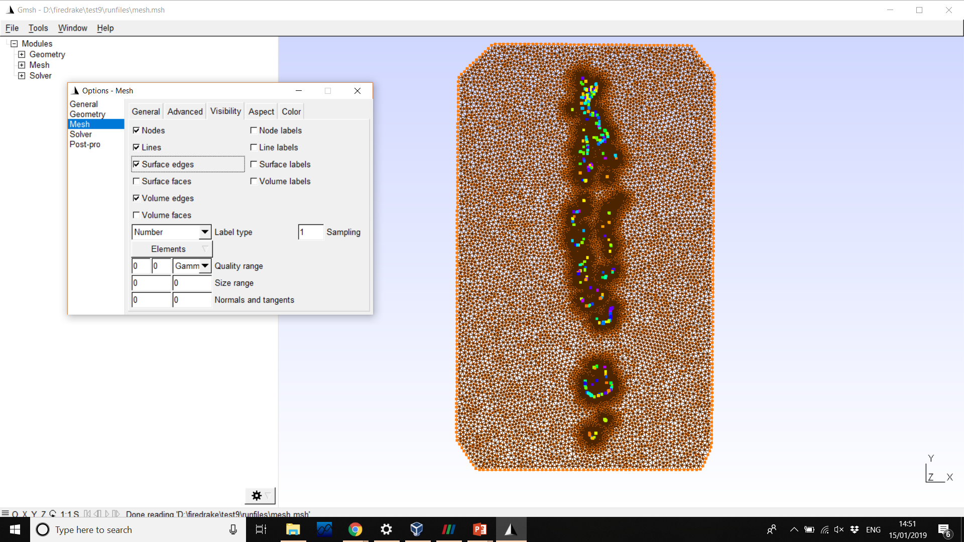
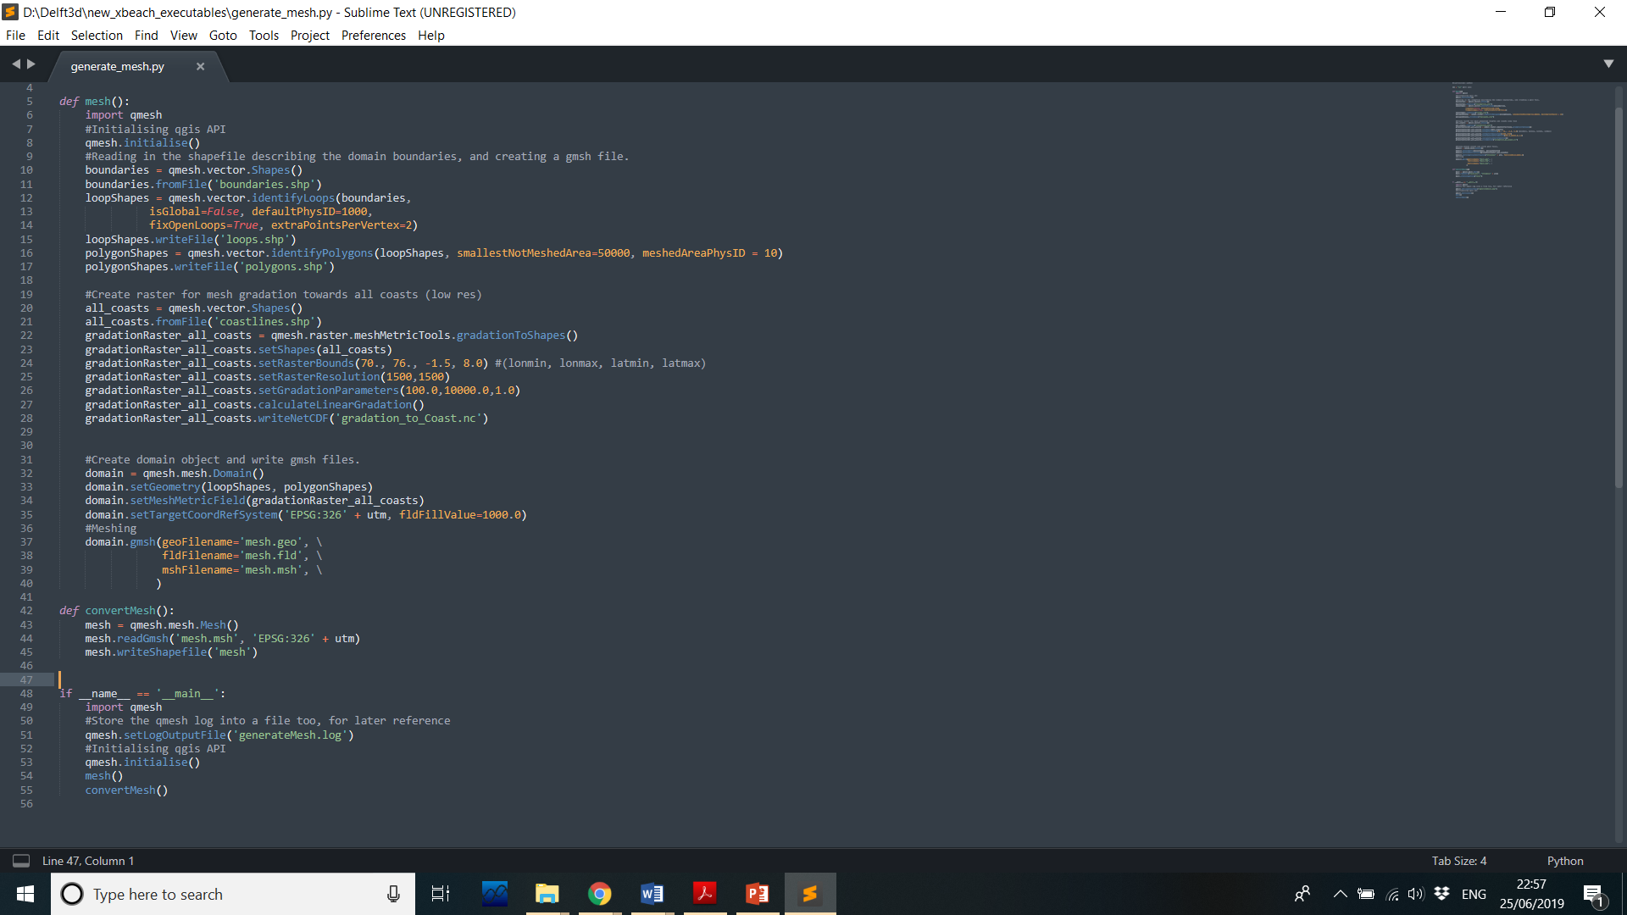
Pre-processing : Mesh Creation
Define the Coastlines and Boundary Shape Files.
Define raster bounds (min.longitude, max.longitude,min.latitude,max.latitude).
Define the resolution of the raster (increasing improves the mesh but takes more time to mesh).
Set the gradation parameters (min to maximum)
qmesh allows us to save the mesh as a shape file which allows us to visualize the mesh in qgis.
Fig : Mesh across the Maldives, Coastlines in Color

Slide 6
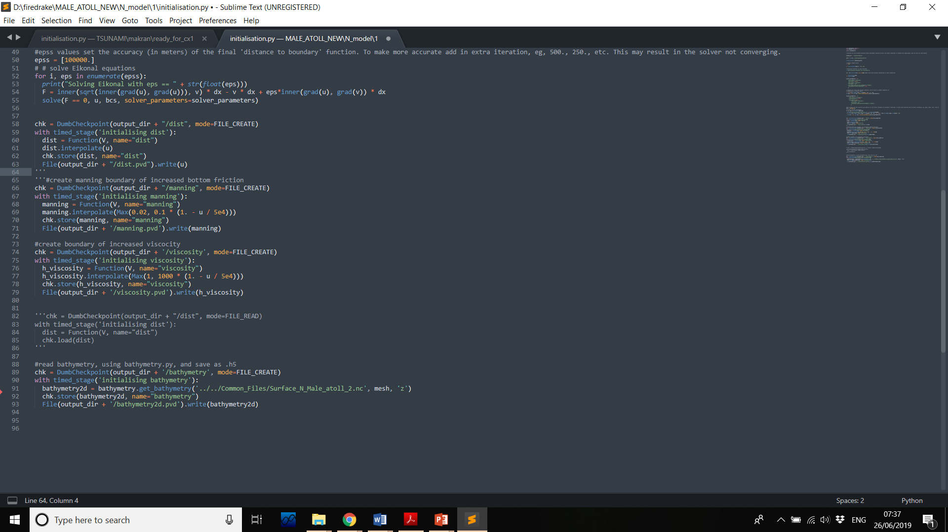
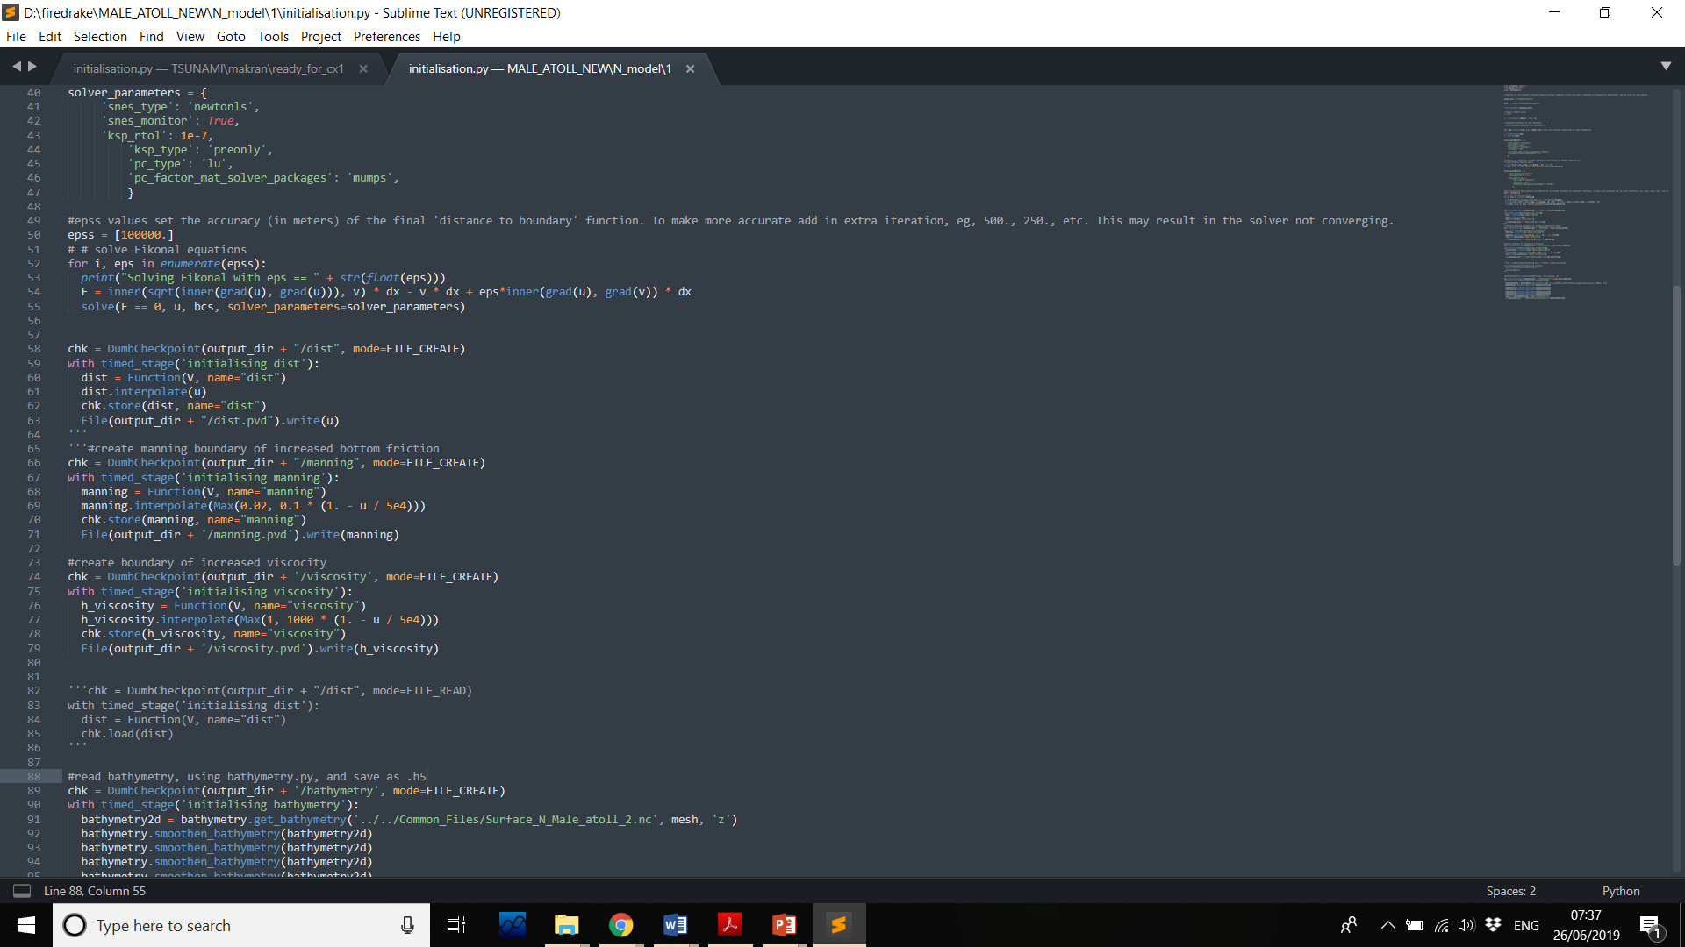
Pre-processing : Bathymetry and Boundary Functions
There are several global bathymetry datasets available, including GEBCO which provides Global bathymetry data at a resolution of 30arc seconds. We use the bathymetry NetCDF file and convert to a hdf5 file which would later be loaded in the model as the bathymetry function.
Next we define the manning roughness coefficient and the viscosity across the domain. Increased viscosity is applied at the open boundaries. These values can be tuned to best suit the model.

Slide 7
Pre-processing : Initial Elevation
To initiate a tsunami from an earthquake, it is necessary to generate a model of how the seafloor moves.
This is often done by starting with a description of an earthquake fault, broken up into a collection of sub faults, with various parameters defined on each sub fault.
For tsunami modeling all we need to know is the motion of the seafloor, which is one boundary of the seismic domain.
It is often sufficient to use the “Okada model” which gives the final deformation of the sea floor due to specified slip on each subfault.
Fault data are available from a variety of sources including USGS.

Slide 8
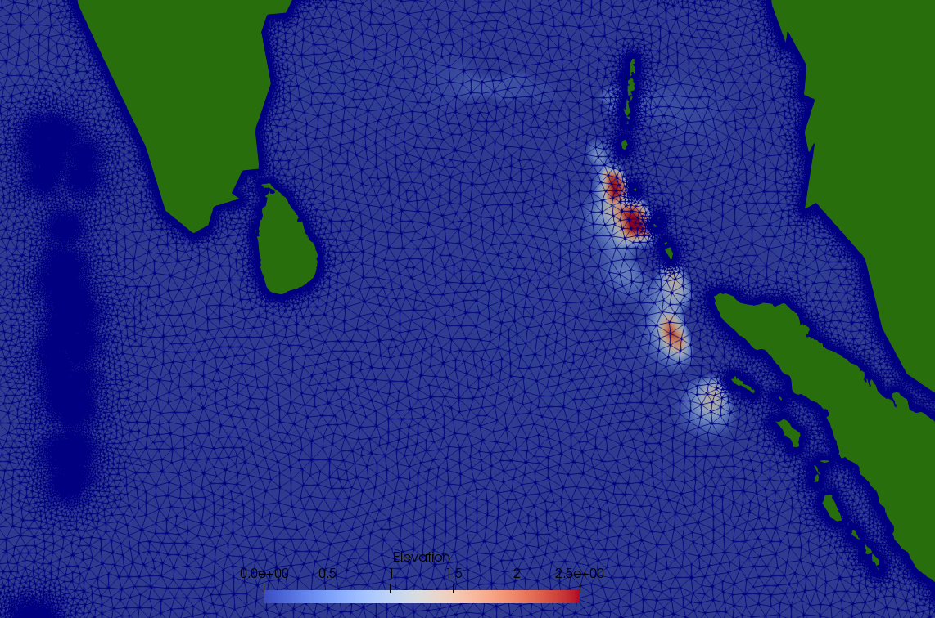
Pre-processing : Initial Elevation
Lat | Lon | Depth[km] | Slip[cm] | Rake | Strike | Dip | L[m] | W[m] | Rupture time(s)
2.22 | 95.33 | 10 | 2110 | 90 | 340 | 10 | 100000 | 100000 | 0
3.14 | 95.14 | 10 | 0 | 90 | 340 | 10 | 160000 | 100000 | 1
4.27 | 94.15 | 10 | 2290 | 90 | 340 | 10 | 150000 | 90000 | 1
5.44 | 93.48 | 10 | 420 | 90 | 340 | 10 | 150000 | 100000 | 3
6 | 94.34 | 27 | 960 | 90 | 340 | 10 | 150000 | 100000 | 3
6.52 | 92.56 | 5 | 510 | 90 | 340 | 10 | 150000 | 100000 | 5
7.08 | 93.42 | 22 | 0 | 90 | 340 | 10 | 150000 | 100000 | 5
8.1 | 92.28 | 5 | 1120 | 90 | 340 | 10 | 150000 | 100000 | 7
8.26 | 93.14 | 22 | 1390 | 90 | 340 | 10 | 150000 | 100000 | 7
9.37 | 92.24 | 10 | 1450 | 90 | 340 | 10 | 100000 | 110000 | 8
10.27 | 92.05 | 10 | 730 | 90 | 340 | 3 | 150000 | 110000 | 10
12.21 | 92 | 5 | 110 | 90 | 10 | 17 | 100000 | 1125000 | 12
The fault parameters are used to generate the initial elevation conditions for our Tsunami model. These elevations can be generated through various tools.
Fig : Fault Paramters for the 2004 Boxing day tsunami
Similar to the bathymetry the elevations are then interpolated on to a firedrake mesh and stored as hdf5 files for input.
Fig : Elevations at 12 seconds after the first rupture

Slide 9
Configuring Thetis
Loading the Bathymetry
Loading the Boundary functions
Accounting for the Coriolis effect
Add detectors
Add the Boundary and Initial Conditions

Slide 10
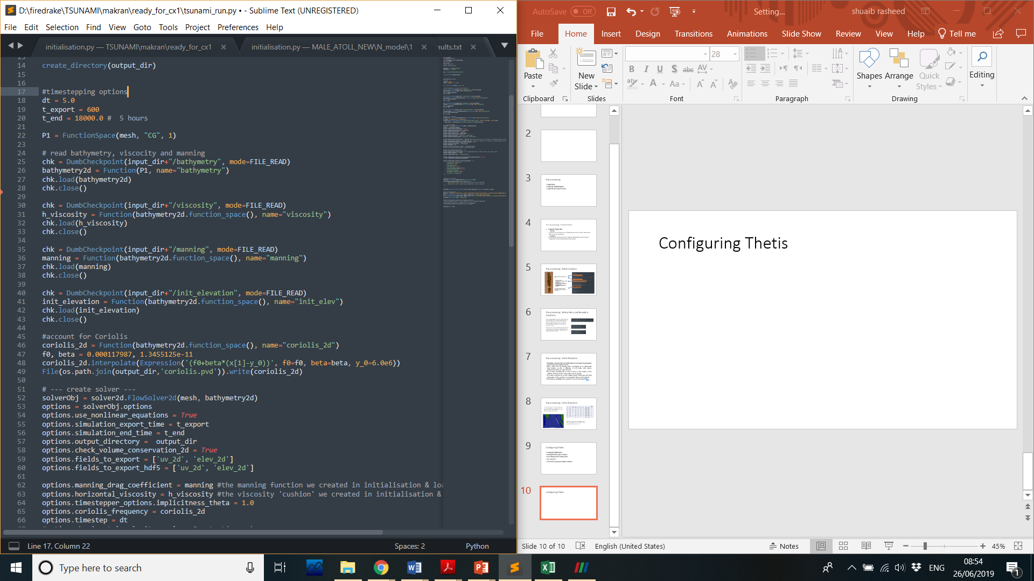
Configuring Thetis
We load the bathymetry, viscosity and the manning functions that we created and stored earlier in the pre-processing stage.
Next we account for the Coriolis effect in the model.
We load the initial elevation that we got from the sub faults. Note that we can load the elevations in several stages according to the rupture time into the model for a more realistic effect.

Slide 11
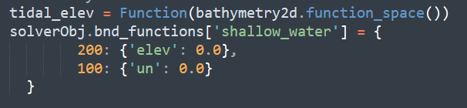
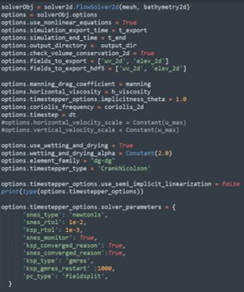
Configuring Thetis
Next we add the boundary conditions, for open boundaries we set the elevations to zero and for the closed boundaries we set zero velocities. Here the coastlines and the boundaries that we defined in mesh generation are respectively the closed and open boundaries.
At this stage we create the solver and setup the different solver options. These include setting up the solver to use the boundary functions that we setup and loaded earlier, different time options, options for outputs and the solver parameters.

Slide 12
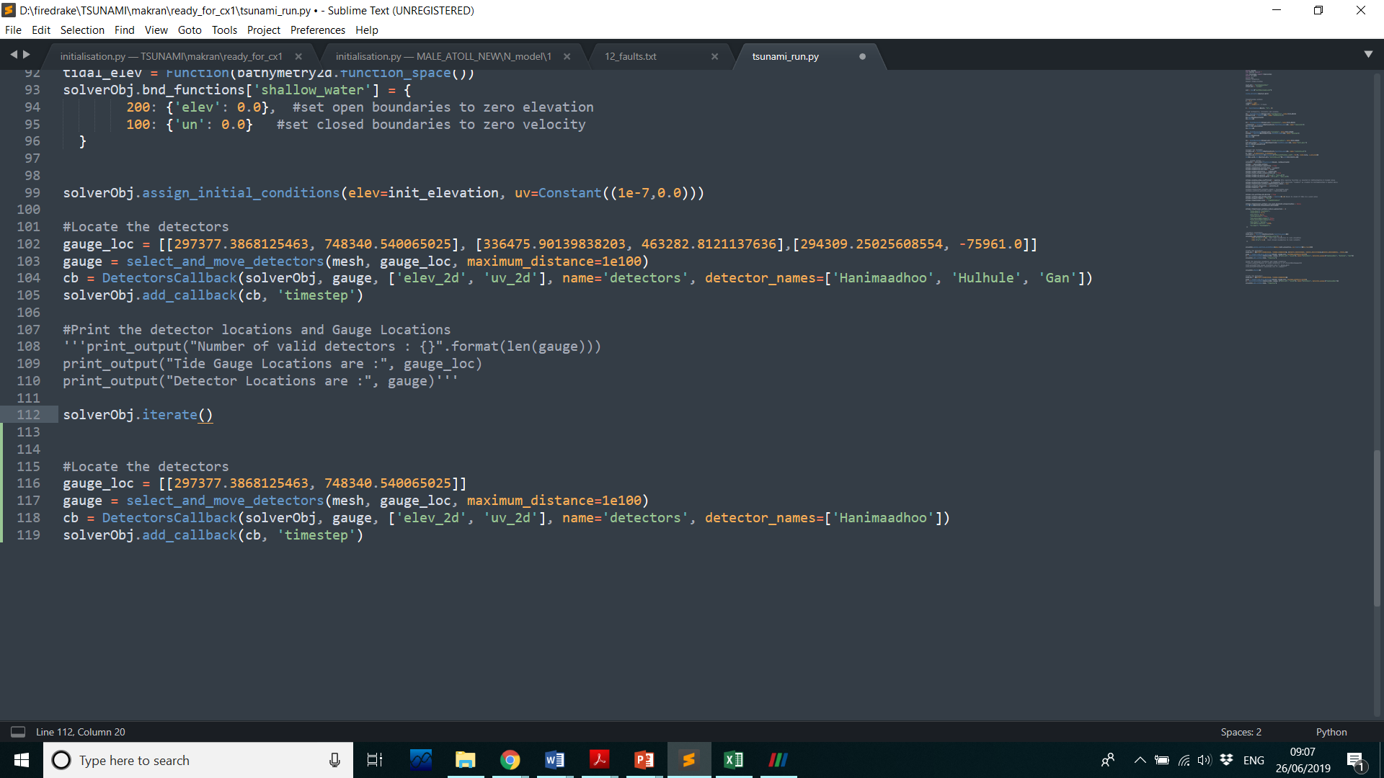
Running the Model
Now we assign the initial conditions, we set the initial elevation to the elevation field that we setup earlier and loaded.
Next we can place detectors or gauges within our mesh which will record the fields. These can then be compared to physically measured data. Here we add a gauge at Hulhule'.
Finally we are ready to set the iterator to run the model.

Slide 13
Visualizing the results
Thetis can export the results of the defined fields at defined export intervals (export intervals and fields to export were defined using the options.) in both VTK and hdf5 format.
VTK files can be viewed using Paraview or any other viewer.
Additionally the detectors will record the values of the fields at each export time which can be compared with field observations.

Slide 14
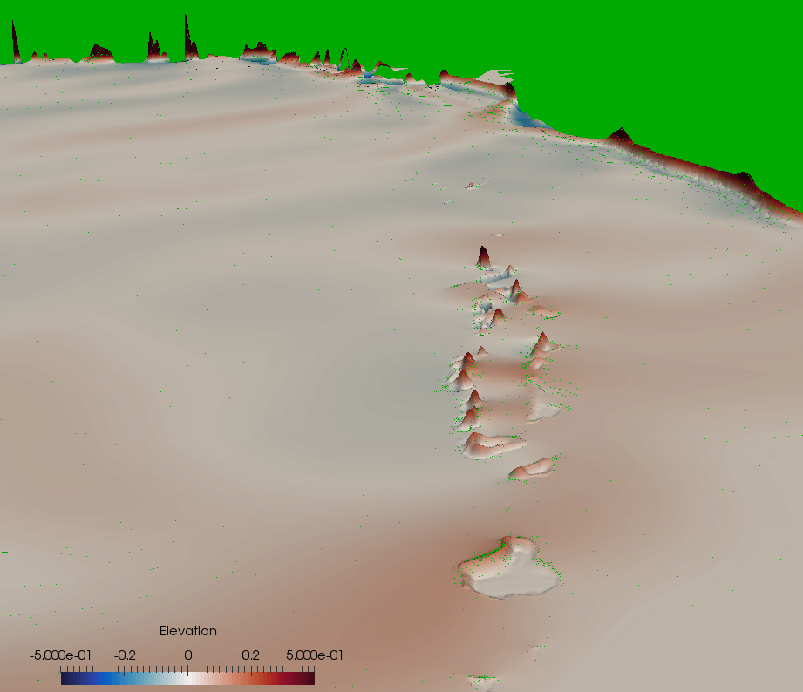
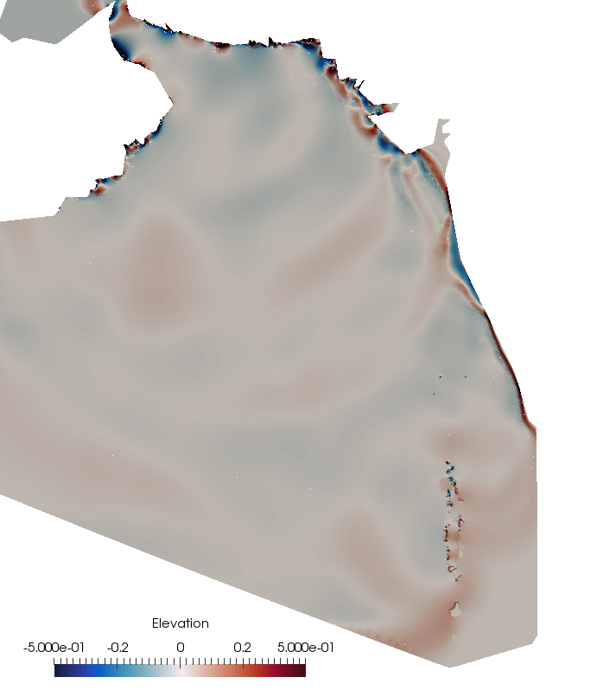
Modelled impact of 1945 Makran tsunami in the Maldives which originated off the coast of Iran/Pakistan. Elevations exagarated by x4000 to see the impact.
Note that the wave passes across the Maldives (~3000km from the source of fault) before it impacts the gulf of Cambay (~1000km from the source)
Fig : Tsunami Elevations in the Indian ocean 3.5 hours after the 1945 Makran earth quake

